Slide 1


Let’s talk about Anxiety
A parent’s guide to supporting children who are anxious

Slide 2
What is anxiety?
Anxiety isn’t an emotion, it is often the result of other emotions such as fear or sadness
Engages our ‘fight, flight, freeze’ response
Anxiety is natural; everyone feels it at some time and it can at times be helpful

Slide 3
What causes anxiety?
Lots of change in a short time
Experiences where a child doesn’t feel ‘safe’
Responsibilities beyond age and developmental stage
Having anxiety ‘modelled’ through someone close
Difficulties at school,; overwhelmed with work, exams, peers.
Family stresses

Slide 4
Signs of anxiety to look out for
Physical symptoms
Panic attacks; racing heart, sweating or shaking, rapid breathing
Feeling sick
Dry mouth
Tense muscles
Wobbly legs
IBS, diarrhoea or increased urination
overheating
Thoughts and feelings
Overwhelmed or out of control
Dread/impeding sense of doom
Alert to noises, smells or sights
Nervous, on edge, panicky
Preoccupied by negative or scary thoughts
Angry outbursts
Coping behaviours
Withdrawal or isolation-avoiding everyday activities
Repeating certain behaviours, actions or rituals
Eating more or less than usual
Sleeping more or less than usual
Self-harming

Slide 5
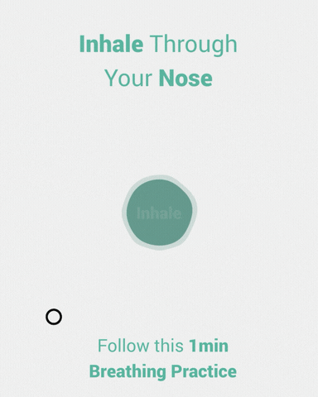
What can help with anxiety?
‘Share your calm, don’t join their chaos’
Validate the emotions they are experiencing and empathise
Support them to understand the difference between a worry and a problem.
Simple techniques:
  5, 4, 3, 2, 1
  Box breathing
  Write and rip
Ask questions that can help avoid catastrophising;
The ‘best friend’ question
The ‘last time’ question
The ‘hard time’ question
The ‘time travel’ question
The ‘mind reading’ question

Slide 6
Where to access help
If your child is experiencing panic attacks or pervasive anxiety that is seriously impacting their day to day life, we would advise contacting your GP for advice on next steps.
Contact the Wellbeing team on wellbeing@warwickschool.org or speak to your child’s Form Tutor or Head of Year to discuss appropriate support in school
Support and guidance can also be found through the following organisations:
Young Minds www.youngminds.org.uk
Anxiety UK www.anxietyuk.org.uk
Charlie Waller Trust www.charliewaller.org

