Slide 1

Warwick School
Academic Support and SEND Provision

Slide 2
Aims
Warwick School’s vision for children with special educational needs and disabilities is the same as for all children and young people – that they achieve and lead happy and fulfilled lives.
‘To provide an outstanding educational experience which promotes equality of opportunity for all our pupils, 11-18, allows them to fulfil their potential, and fully prepares them for further education and the global environment beyond.’
Warwick School is an inclusive and equal opportunity establishment. Pupils identified as having a special educational need or a disability will, like all pupils at Warwick School, be entitled to access the full school teaching curriculum and be encouraged to take advantage of the opportunities offered by the school to achieve their full potential in all areas of school life.
For those identified as having special educational needs or a disability, Warwick School is committed to providing the appropriate support, as best as it can reasonably accommodate, so that they can become individual, independent learners and fulfil their potential through high attainment and achievement whilst ensuring a successful transition to adulthood.

Slide 3
SEND at Warwick
Around 10% of pupils at Warwick have a SEND. These include: processing challenges, neurodivergence, physical differences and SEMH challenges. At Warwick School, pupils who have a diagnosis of need, a centre-determined exam access arrangement or an observed need which is met by our universal provision will appear on our Additional Need Register. Those pupils with similar characteristics but who require additional support beyond that of our universal offering will appear on our SEND Register. All pupils with a determined need will have a PEN (personal educational need) Portrait and be monitored by the Academic Support department.
In addition to SEND, the Academic Support department supports pupils with EAL. EAL pupils can be part of our overseas community, or they may be day pupils where English is not the predominant language used at home. These pupils will appear on our EAL Register.

Slide 4
Ethos
Empathy- Making a connection with every child matters
Responsibility – A universal approach in which an educational need is best met within the mainstream classroom
Strategy- Adaptive teaching at the heart of every lesson, with both teachers and pupils supported by the Academic Support and SEND department

Slide 5
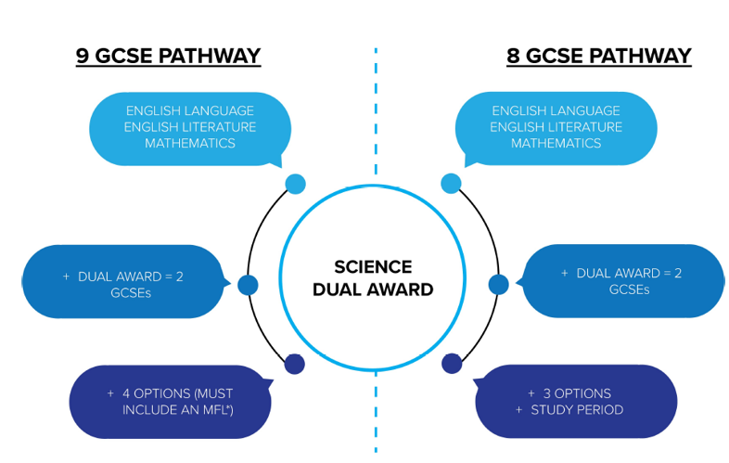
What do we offer
An Adapted Curriculum
The Warwick School day is busy! To accommodate the many clubs and societies, lunchtimes and after school are already populated with many activities. Therefore, to provide additional support, we might need to adapt a pupil’s timetable to do this.
For example, in years 7-9 some pupils might not learn a second modern foreign language, or they may not learn Latin. Instead, they will attend 1:1 or small group lessons with Academic Support, in the Aspire Hub, designed to support them in Maths, English and the learning skills required to best access the mainstream classroom. We offer this to a small number of pupils who we think might benefit from this intervention.
In addition, at GCSE level, pupils can opt for the 8 GCSE pathway, allowing them private study time in the timetabled week ( the extra time that they may already have in the form of an exam access arrangement) and a chance to have further support in key areas such as Maths and English. They might also access supported private study sessions, in which study skills and revision top tips are modelled and practised, furthering productivity and efficacy in their independent work.

Slide 6
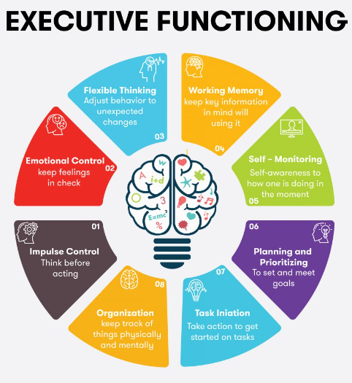
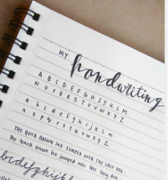

What do we offer
Skills Clubs
The department currently runs four key skills clubs, they are:
InkMasters (Handwriting)
TaskMasters (Organisation and Planning- a self-evaluation of their executive functioning)
MemoryMasters (Revision and Study Skills- working memory aids)
Connection Corner (SEMH)

Slide 7
What do we offer
SEMH
Social Emotional and Mental Health support is fully integrated into Warwick School. In addition to the extensive tutoring, house systems and peer mentoring schemes that help provide outstanding pastoral care for our pupils, the Wellbeing HUB is accessible to all and can provide specialist support if necessary.

Slide 8

Key Contacts
Head of Academic Support and SEND
Mrs Anna Albrighton a.albrighton@warwickschools.co.uk
Senior Mental Health Lead
Mrs Helen Leaf h.leaf@warwickschools.co.uk and wellbeing@warwickschools.co.uk
EAL Coordinator
Mrs Mandy Lee a.lee@warwickschools.co.uk

